Slide 1
Price Promotions & Customer Lifetime Value
Pricing Strategies
2025
Jean-Pierre Dubé
© Copyright 2025

Slide 2
Overview
Pricing as an investment
Pricing objectives & the lifetime value of the customer
Pricing decisions to balance acquisition & retention
Pricing & CRM

Slide 3
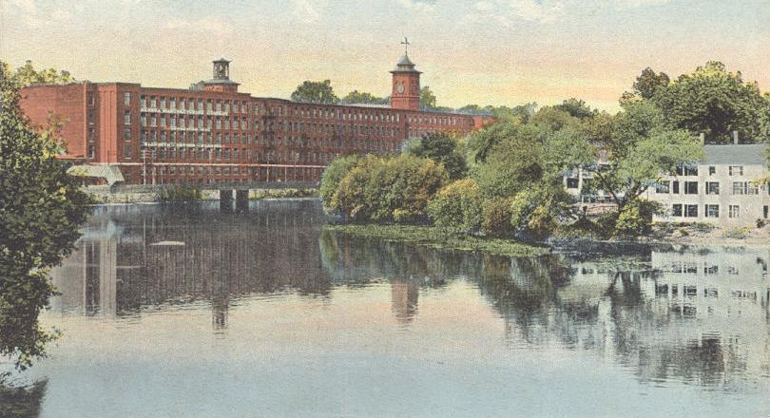

Case Study: Nashua Photo
See Appendix for examples of coupons as segmented pricing

Slide 4
Evaluating Price Promotions Example: Nashua Photo
Based on 1993 Efficiency Report, how does Nashua evaluate its price promotion campaigns?
Average cost per respondent across campaigns is $2.40
Click to see entire list of campaigns

Slide 5
Evaluating Price Promotions Example: Nashua Photo
Return on marketing investment
How effective are these campaigns?
Avg promotional GM = $1.07
Only 4 campaigns with ROMI>0
Click to see entire list of campaigns

Slide 6
Evaluating Price Promotions Example: Nashua Photo
What about cannibalization of bounce-back mailers? Suppose 10% of repeats would have used bounce-back…
Only 1 campaigns with ROMI>0
Click to see entire list of campaigns

Slide 7

Long Run Effects of Promotions
Price promotion induces trial
Trial may lead to future repeat purchases
How much should firm be willing to discount price to acquire a new customer?

Slide 8
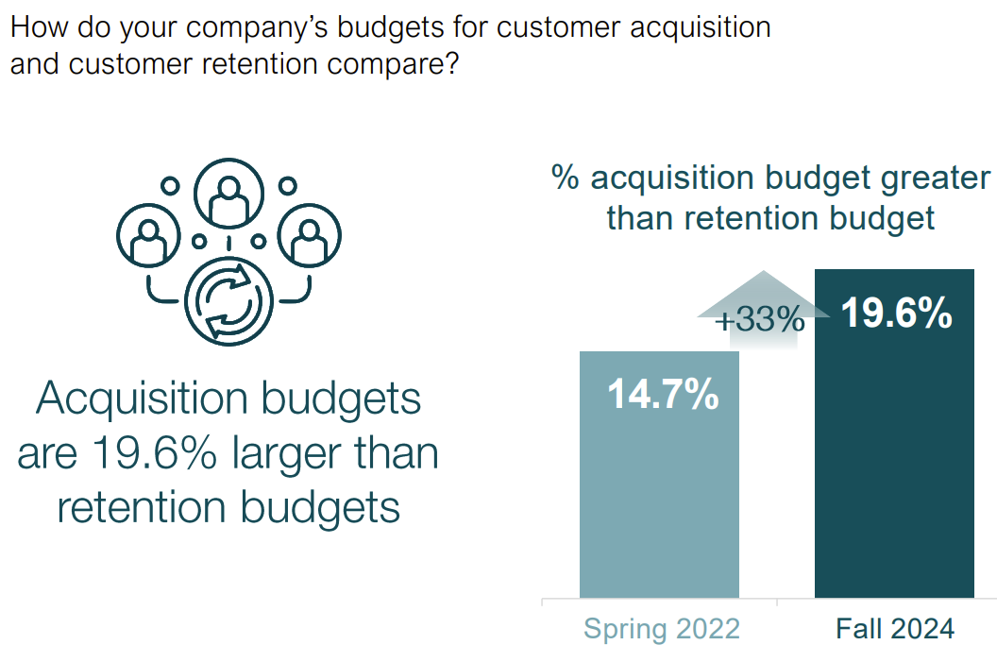
“Companies spend 19.6% more on customer acquisition than on customer retention, up from 14.7% in 2022”
Source: CMOSurvey.org, 2024

Slide 9
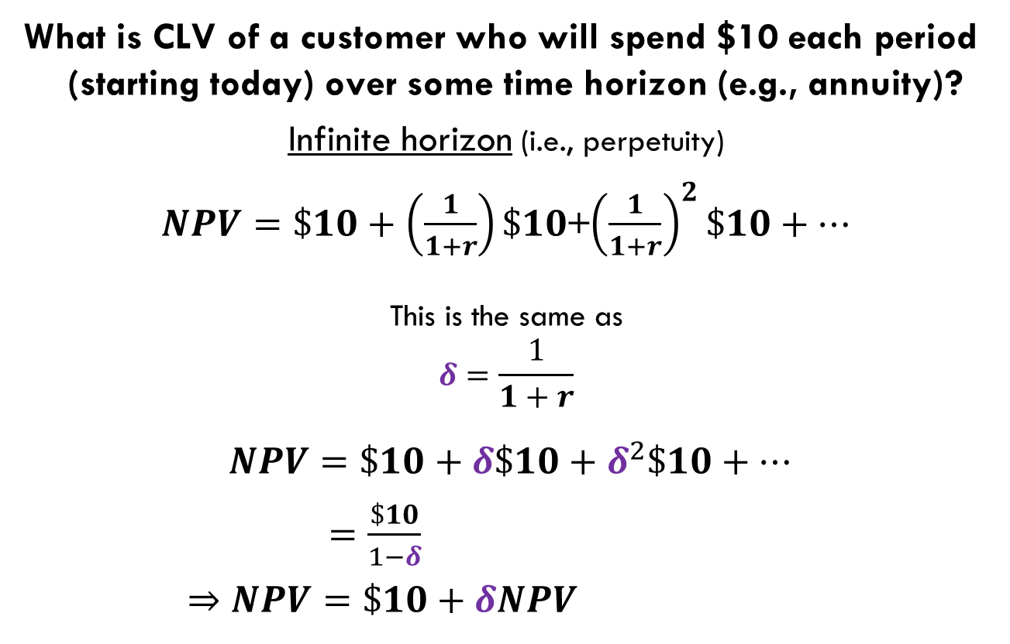
Customer Lifetime Value (CLV) Simple NPV Calculation for customer’s cash-flow
What is CLV of a customer who will spend $10 each period (starting today) over some time horizon (e.g., annuity)?
Infinite horizon (i.e., perpetuity)
$NPV=\$10+\left(\frac{1}{1+r}\right)\$10$+${\left(\frac{1}{1+r}\right)}^{2}\$10+…$
This is the same as
$$δ=\frac{1}{1+r}$$
$NPV=\$10+δ\$10+δ^{2}\$10+…$
$=\frac{\$10}{1−δ}$
⇒ $NPV=\$10+δNPV$
r = interest rate
i.e., Firm’s cost of capital
discount factor
this recursive formulation
will be useful shortly.

Slide 10
LR promotion benefit: Customer Journey example: Nashua Photo
Promo sent to prospective customer
Start 4 semi-annual bounce-back mailers for first-timers
Not Buy
Terminate
Buy
60%
First-time Buyer (B)
20%
10%
Get ‘Em
Return Buyer (R)
90%
40%
Keep ‘Em
Loyal Buyer
(L)
transition probabilities: use existing field data or run field experiment to obtain these
80%
Grow ‘Em

Slide 11
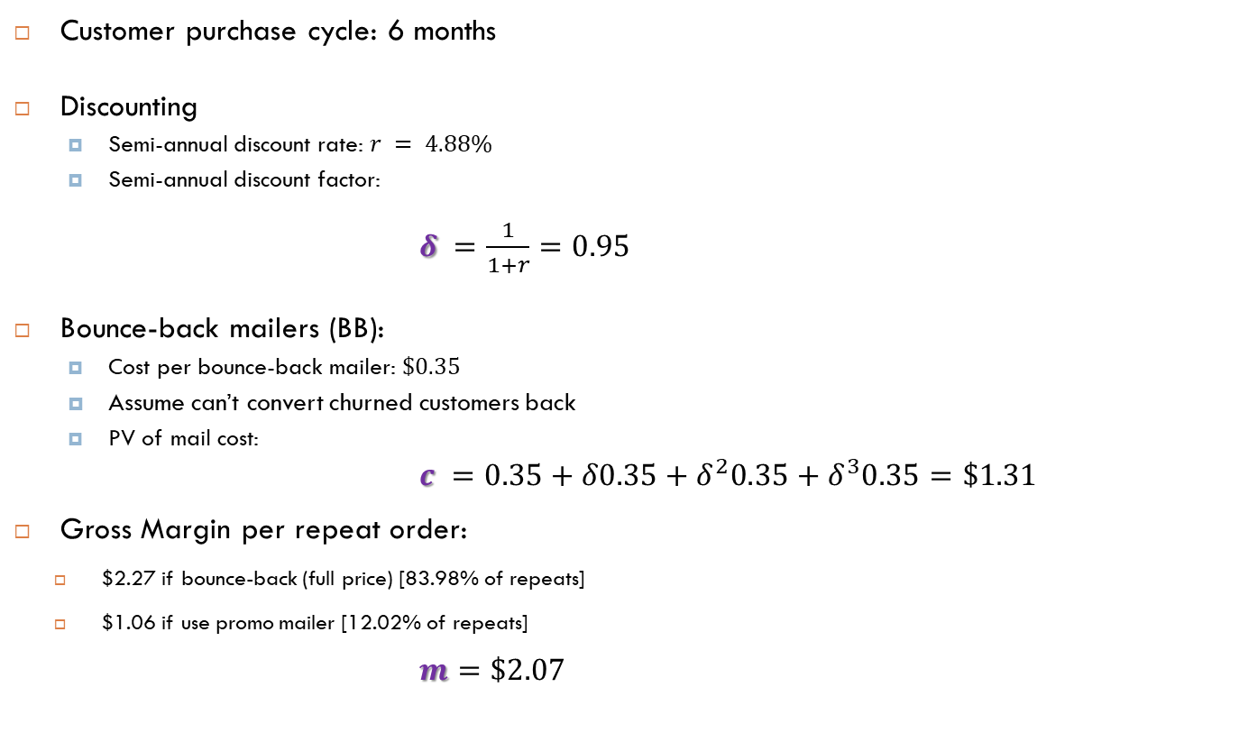
Assumptions to measure LR benefits example: Nashua Photo
Customer purchase cycle: 6 months
Discounting
Semi-annual discount rate: $r = 4.88\%$
Semi-annual discount factor:
$δ =\frac{1}{1+r}=0.95$
Bounce-back mailers (BB):
Cost per bounce-back mailer: $\$0.35$
Assume can’t convert churned customers back
PV of mail cost:
$c =0.35+δ0.35+δ^{2}0.35+δ^{3}0.35=\$1.31$
Gross Margin per repeat order:
$2.27 if bounce-back (full price) [83.98% of repeats]
$1.06 if use promo mailer [12.02% of repeats]
$m=\$2.07$
Notes:
Equivalent to 10% annual interest rate

Slide 12
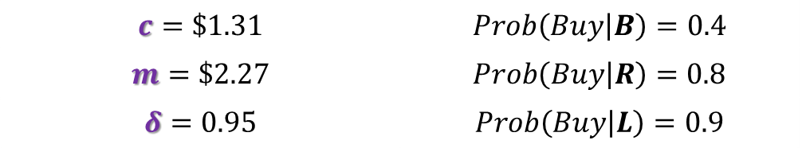
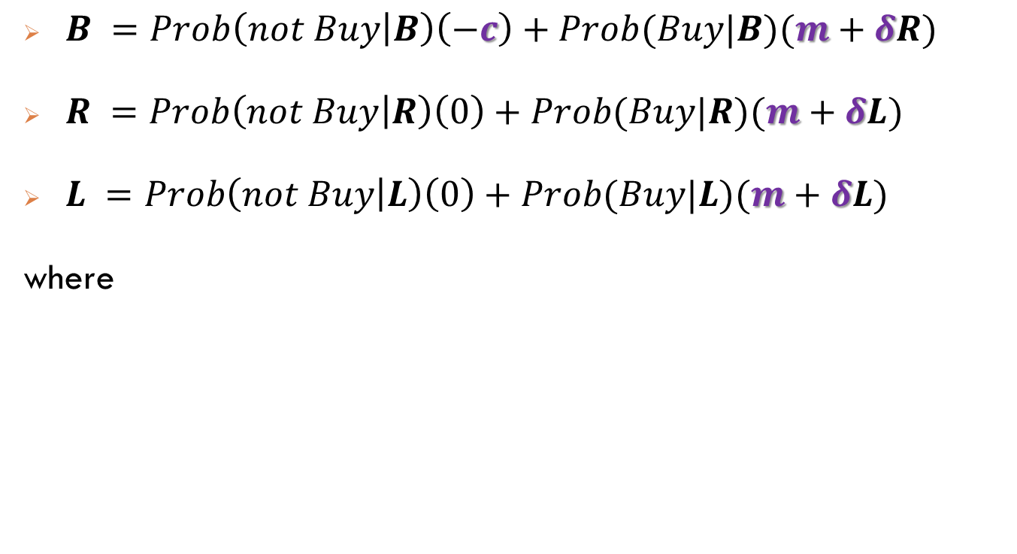
CLV of a Buyer model example: Nashua Photo’s 3 buyer types
First-time
buyer
$B =Prob\left(not Buy | B\right)\left(−c\right)+Prob(Buy|B)(m+δR)$
$R =Prob\left(not Buy | R\right)\left(0\right)+Prob(Buy|R)(m+δL)$
$L =Prob\left(not Buy | L\right)\left(0\right)+Prob(Buy|L)(m+δL)$
where
Repeat
buyer
Loyal
buyer
$$c=\$1.31$$ | $$Prob\left(Buy | B\right)=0.4$$
$$m=\$2.27$$ | $$Prob\left(Buy | R\right)=0.8$$
$$δ=0.95$$ | $$Prob\left(Buy | L\right)=0.9$$

Slide 13

CLV of a Buyer model example: Nashua Photo’s 3 buyer types
First-time
buyer
$B =0.6×\left(−\$1.31\right) + 0.4×(\$2.07+0.95R)$
$R =0.2×\left( \$0 \right) + 0.8×(\$2.07+0.95L)$
$L =0.1×\left( \$0 \right) + 0.9×(\$2.07+0.95L)$
Repeat
buyer
Loyal
buyer
3 equations & 3 unknowns: B, R and L
Can you solve it? (you could literally use pencil & paper)
Can you interpret the solution?
Let’s ask ChatGPT!!!!

Slide 14
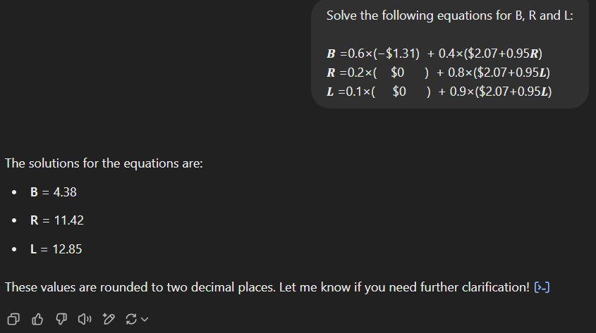
CLV of a Buyer model example: Nashua Photo’s 3 buyer types

Slide 15
CLV of a Buyer model example: Nashua Photo’s 3 buyer types
Interpret the solution for B
See Appendix for solution using (i) Excel solver, (ii) R

Slide 16
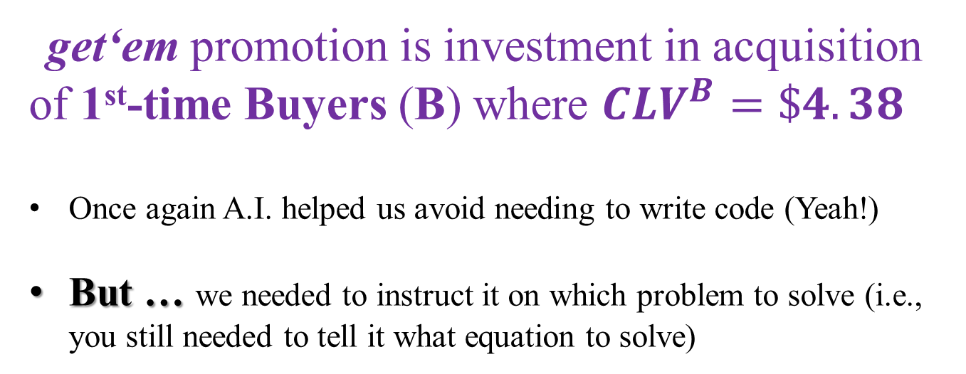
CLV of a Buyer example: Nashua Photo’s 3 buyer types
get‘em promotion is investment in acquisition of 1st-time Buyers (B) where $CLV^{B}=\$4.38$
Once again A.I. helped us avoid needing to write code (Yeah!)
But … we needed to instruct it on which problem to solve (i.e., you still needed to tell it what equation to solve)
Note: R and Excel solutions will give slightly different results because above I’ve rounded the discount factor to 0.95

Slide 17
Evaluating Price Promotions with CLV Example: Nashua Photo
Which coupons are valuable when positive CLV is added?
Accounting for CLV, 103 campaigns with ROMI>0!!!
(over 80% of campaigns!)

Slide 18
Price Promotion & CLV of customer Example: Free Unlimited Service at Sprint
“Sprint’s Latest Salvo in Wireless Price War: Free, Unlimited Service”
Ryan Knutsen, Wall Street Journal, 6-13-2017
One year free service if switch from rival
Unlimited text, data, calling
Hidden: sim card ($2.99), shipping ($10), monthly fees and taxes
Sprint’s argument:
Offer only advertised online and sign-up online
Lower acquisition cost than other forms of advertising
Concern:
Targeted at Verizon customers
competitive reaction!
Free?

Slide 19



CLV Pricing and Marketing for Bad? Example: Free OxyContin & addiction
Purdue used a “patient starter coupon program”
Free limited-time subscription for 7 to 30 days
34,000 coupons redeemed nationally in 2001
See https://www.ncbi.nlm.nih.gov/pmc/articles/PMC2622774/

Slide 20


CLV Pricing and Marketing for Good? Example: Netflix and inattention
“Netflix’s Plan to Auto-Cancel Subscriptions Is Radically Sane”
Brian Barrett, Wired, May 24, 2020
“If you don’t watch anything on Netflix for a year after you join, the company will send you an email asking if you want to keep your membership. You’ll also get a message if you go two years without watching anything on Netflix at any point. If you write back to say, "Yes, please keep charging me for all these seasons of Riverdale I’m ignoring," nothing changes. If you ask to cancel or don’t write back at all, Netflix automatically stops charging you.”

Slide 21


CLV Pricing: acquisition & retention Example: Ziprecruiter.com
21
Recall online recruiting B2B pricing experiment
Originally charging $99 per month
August 2015, tested 10 randomized price levels
Determined $281 optimal in short-run
Can $99 be rationalized under CLV?

Slide 22
Pricing and CLV at Ziprecruiter Pricing & Retention
What about customer retention?
Cash flows from all subsequent months customer survives
Plausible that retention decreases for higher prices
So retention is not a fixed number, it’s a function of price

Slide 23
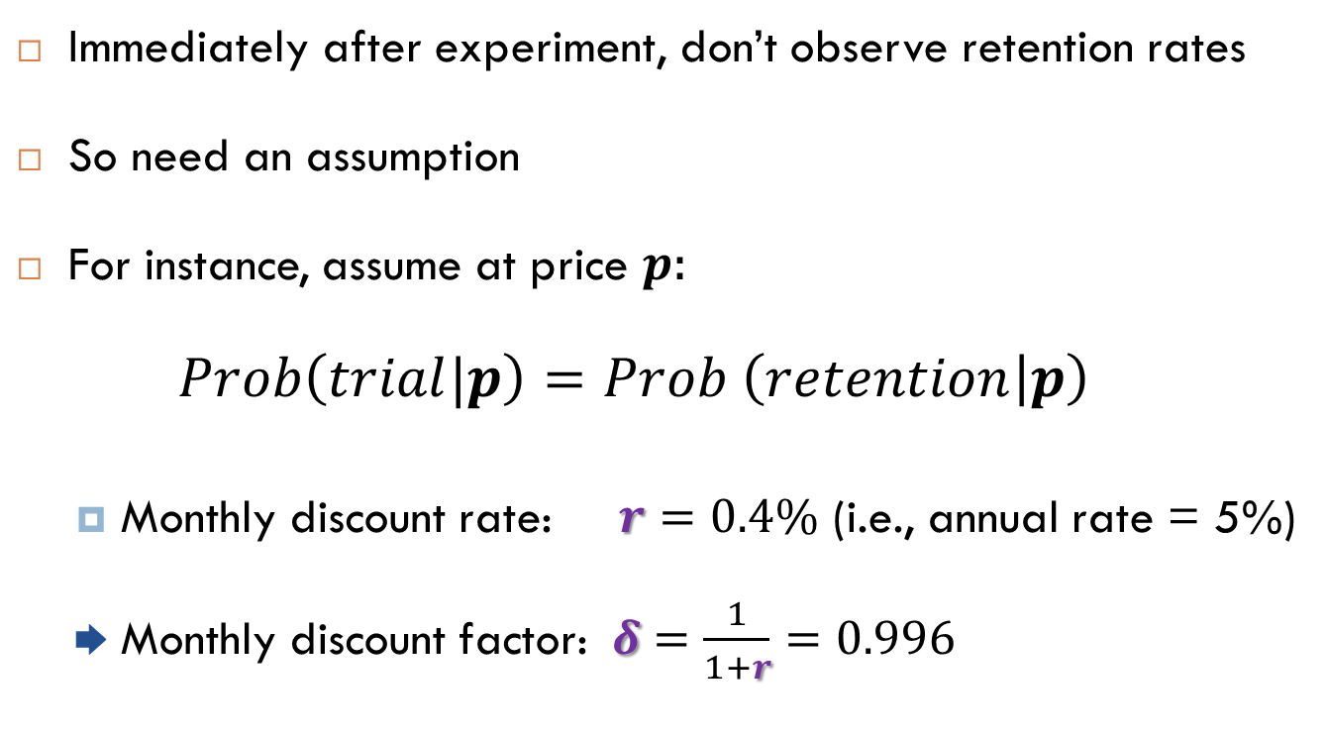

Pricing and CLV at Ziprecruiter Measuring Retention
Immediately after experiment, don’t observe retention rates
So need an assumption
For instance, assume at price $p$:
$$Prob\left(trial|p\right)=Prob \left(retention | p\right)$$
Monthly discount rate: $r=0.4\%$ (i.e., annual rate = 5%)
Monthly discount factor: $δ=\frac{1}{1+r}=0.996$
See Appendix for retroactive analysis using actual retention rates

Slide 24
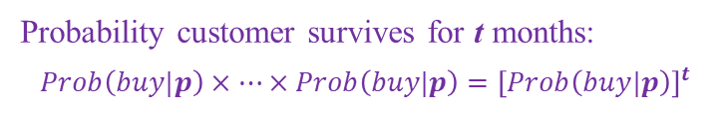
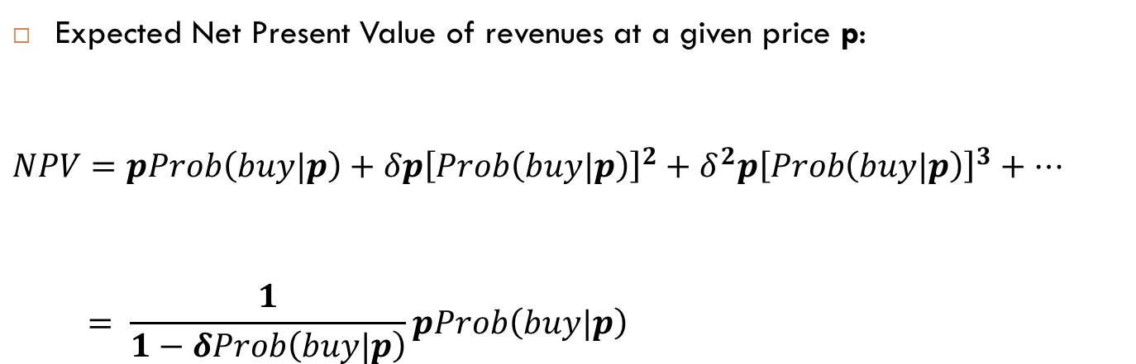
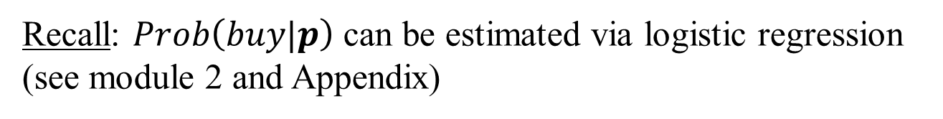
Pricing and CLV at Ziprecruiter Assume retention rate same as acquisition rate
Expected Net Present Value of revenues at a given price p:
$$NPV=pProb\left(buy|p\right)+δp{\left[Prob\left(buy|p\right)\right]}^{2}+δ^{2}p{\left[Prob\left(buy|p\right)\right]}^{3}+…$$
$$= \frac{1}{1−δProb\left(buy|p\right)}pProb\left(buy|p\right)$$
Acquisition
Discounted future Retention
( )
Probability customer survives for t months:
$$Prob\left(buy|p\right)×…×Prob\left(buy|p\right)={\left[Prob\left(buy|p\right)\right]}^{t}$$
Retention value
(i.e., CLV)
Recall: $Prob\left(buy|p\right)$ can be estimated via logistic regression
(see module 2 and Appendix)

Slide 25
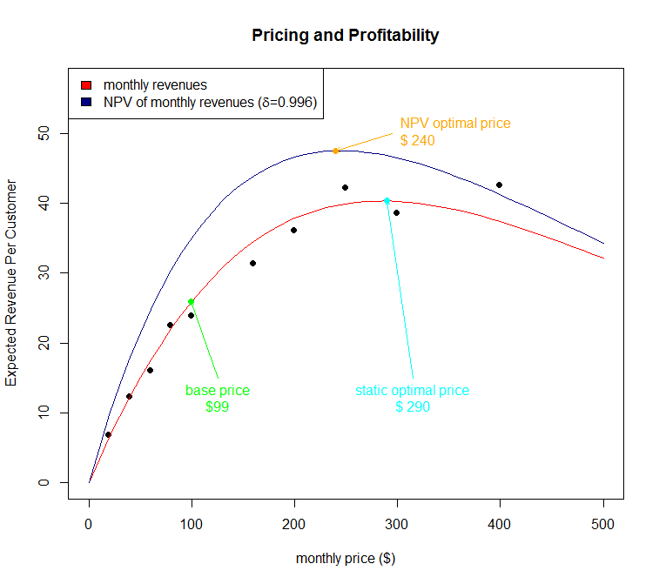
Pricing and CLV at Ziprecruiter Assume retention rate same as acquisition rate
(r=0.05)
Note:
Pricing to CLV did not improve Ziprecruiter’s profits much due to relatively low repeat rates
Growth mainly from static optimization as in weeks 2 & 5
$249
See Appendix for R code
Optimal lifetime value price slightly lower: $240

Slide 26
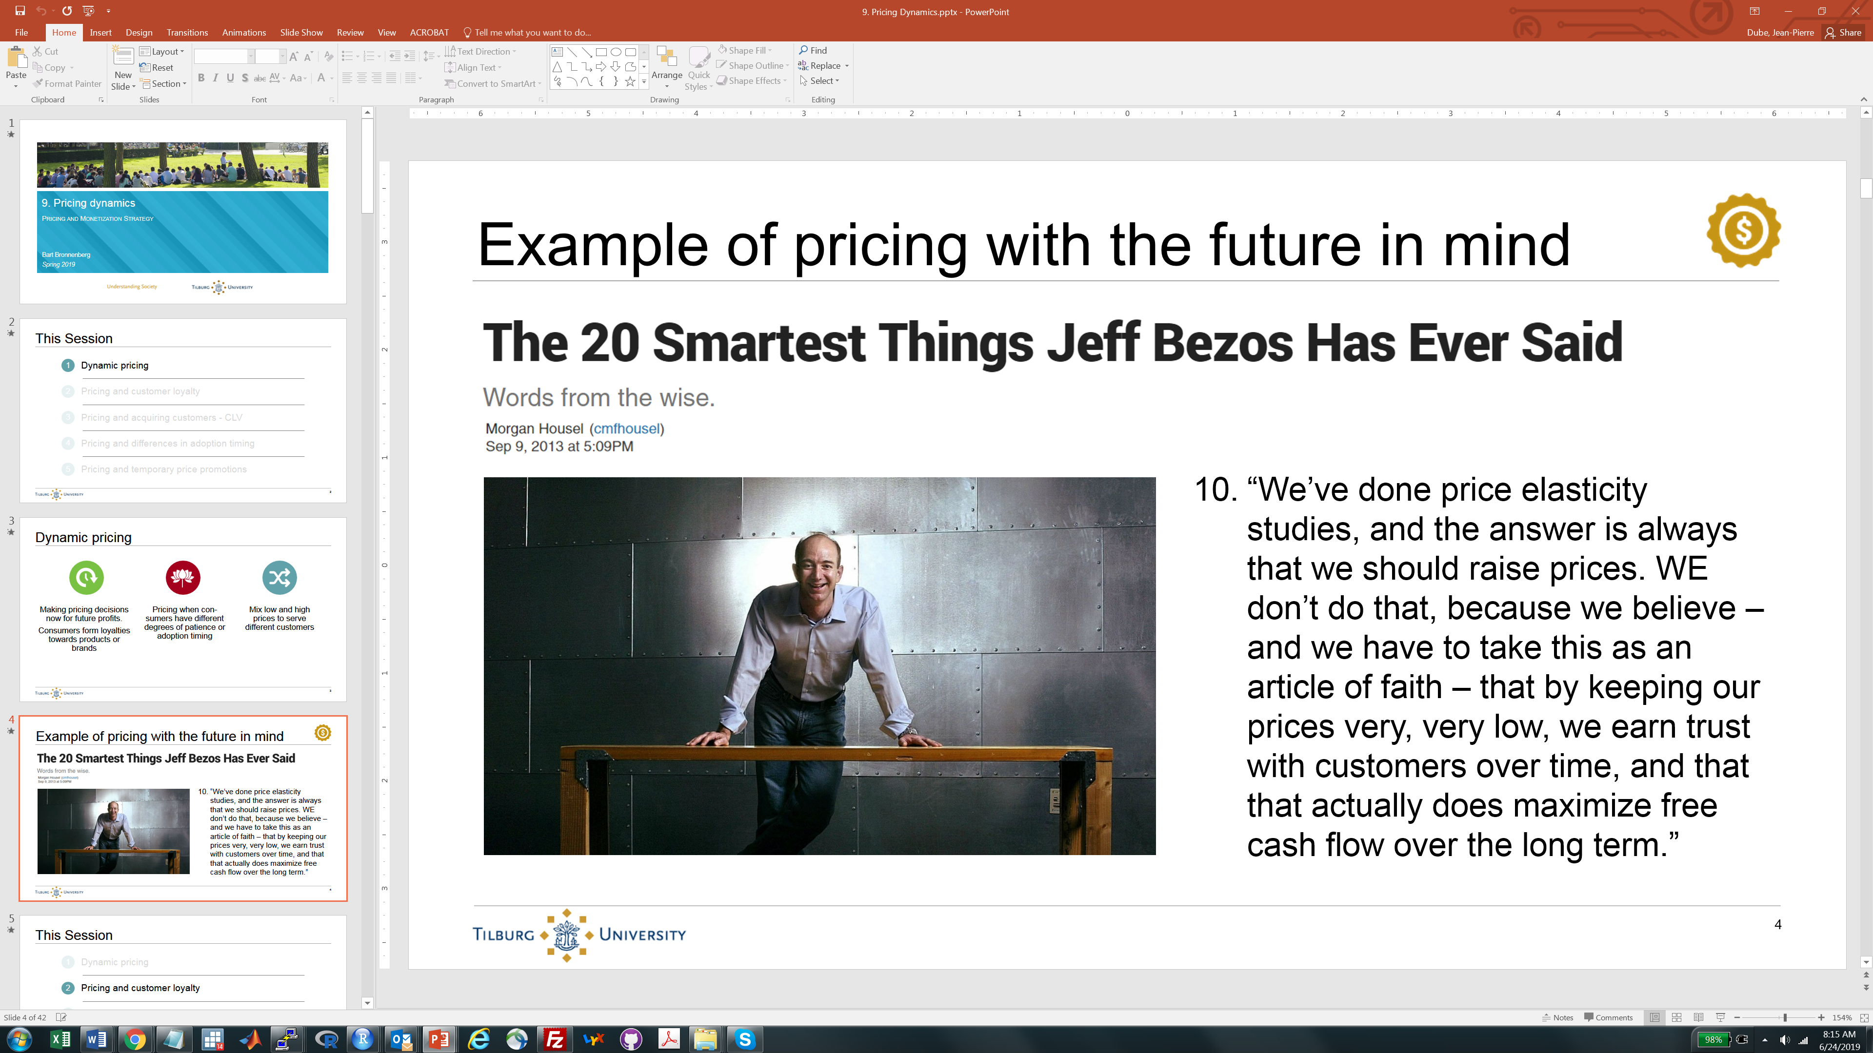
Pricing and CLV at Amazon

Slide 27
Take-Away
Price discounts and CLV
Pricing & CRM – balancing acquisition & retention
Think Razors & Blades over time (initial trial = Razor)
See Appendix for “Freemium” as pricing to CLV

Slide 28
Extra
Coupons as Segmentation

Slide 29
Promotions as a “One Time Gain” Example: Coupons…But is it always profitable?
2 types of customers who vary in disutility of coupon
Segment WTP Disutility Size
H $15 -$5 100
L $11 -$4 100
What’s the optimal uniform price?
Strategy 1: Shelf Price=$15, profit: $1500
Strategy 2: Shelf Price=$11, profit: $2200
What’s the optimal coupon price?
hint: This is just product line pricing…
Strategy 3:
Coupon face value: $4.99
Shelf Price: $7 + $4.99 = $11.99
Profit = $1199 + $700 = $1899

Slide 30
Promotions as a “One Time Gain” Exercise
Would you ever offer both a coupon and a price discount at the same time?
2 types of customers who vary in disutility of coupon
Segment WTP Disutility Size
H $15 -$5 100
L $7 -$1 100

Slide 31
Extra
Using Solver in Excel to compute CLV of consumers at different stages of relationship

Slide 32
The solver add-in
In Excel:
Go to “Options,” then “add-ins” and select “solver”
Under “Manage” select “Excel Add-ins”
In menu above, select “Solver Add-in”
Click “Go”
Make sure “Solver Add-in” is checked and hit “ok”

Slide 33
The spreadsheet
This is the spreadsheet built into the slides

Slide 34
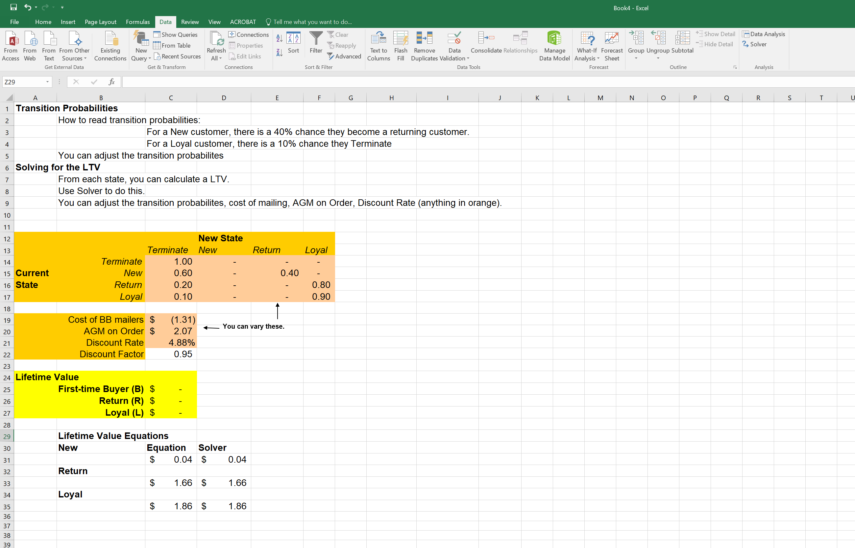
Use solver to compute CLV of consumer types B, R and L
Go to “Data” tab and click on “Solver” in “Analysis” group

Slide 35
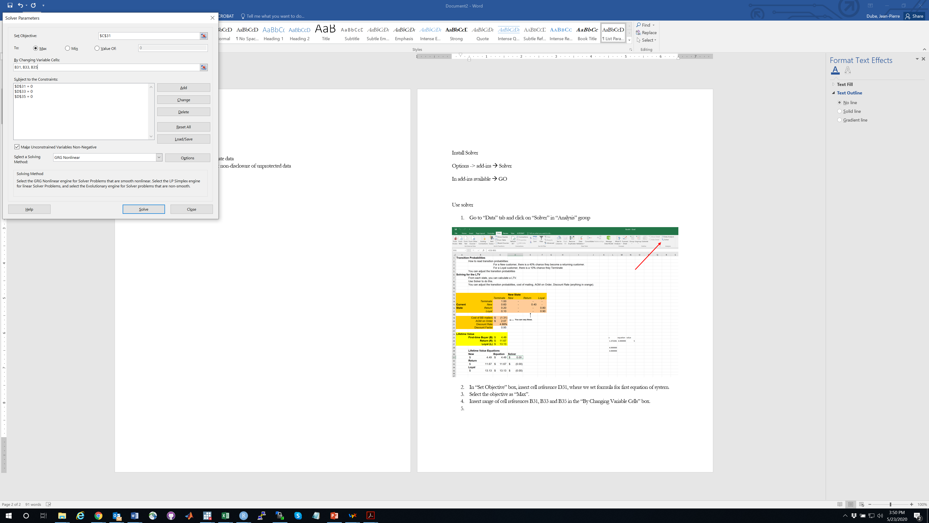
Enter equations into solver
In “Set Objective” box, insert cell reference C31, where we set formula for first equation of system.
Select the objective as “Max”.
Insert range of cell references B31, B33 and B35 in the “By Changing Variable Cells” box.

Slide 36
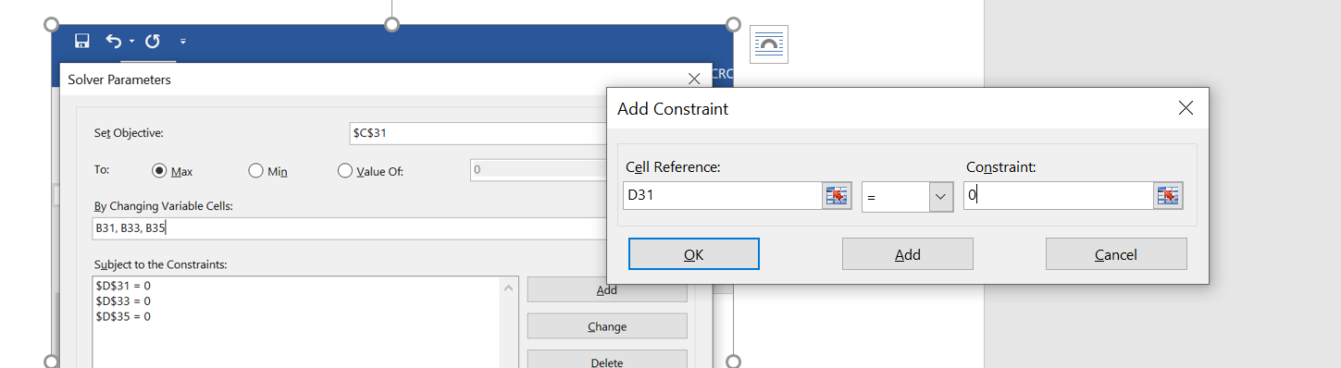
Enter constraints
In “Subject to Constraints” box, add constraints for each of the equations by clicking on “Add” button.
In “Add Constraints” window, enter the constraints for all equations one by one by pressing “Add” button. Press OK button when done with adding all the constraints.

Slide 37
Now solve the system
Press “Solve” button

Slide 38

Solved
Here’s the solution

Slide 39

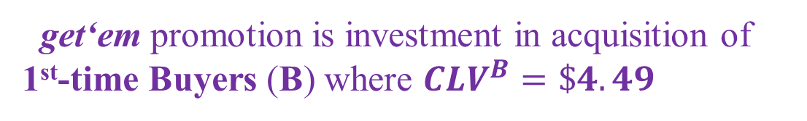
CLV of a Buyer example: Nashua Photo’s 3 buyer types
Click to see CLV analysis via solver
(steps in Appendix)
get‘em promotion is investment in acquisition of 1st-time Buyers (B) where $CLV^{B}=\$4.49$

Slide 40
Using R to solve Nashua
I personally think this is easier!

Slide 41
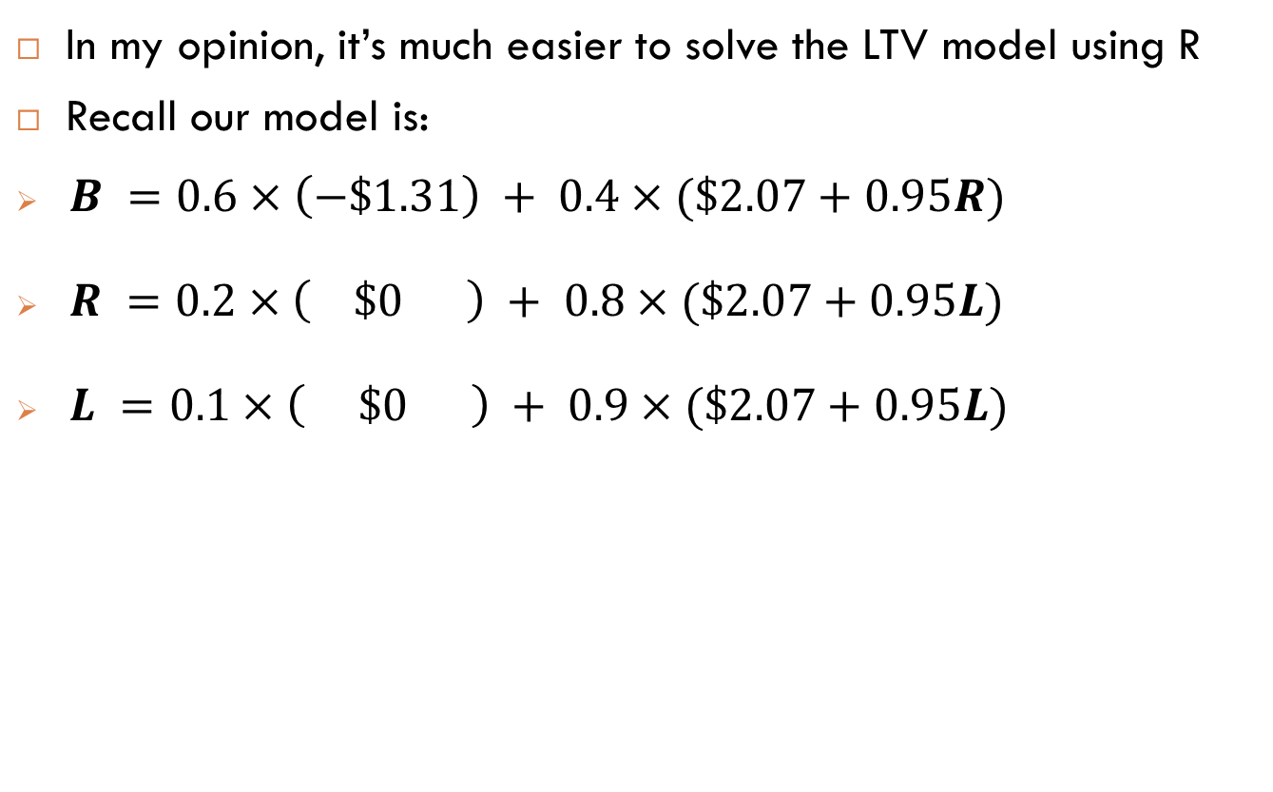
Overview
In my opinion, it’s much easier to solve the LTV model using R
Recall our model is:
$B =0.6×\left(−\$1.31\right) + 0.4×(\$2.07+0.95R)$
$R =0.2×\left( \$0 \right) + 0.8×(\$2.07+0.95L)$
$L =0.1×\left( \$0 \right) + 0.9×(\$2.07+0.95L)$

Slide 42
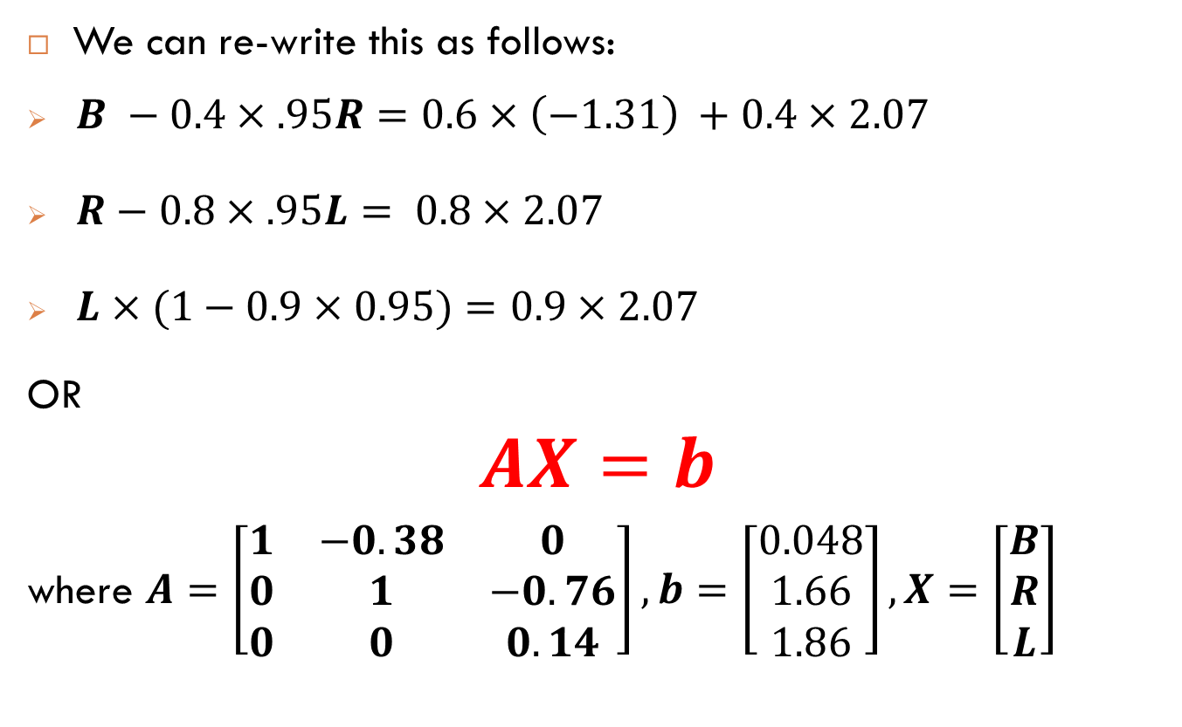
Writing the model in matrix form
We can re-write this as follows:
$B −0.4×.95R=0.6×\left(−1.31\right) +0.4×2.07$
$R−0.8×.95L= 0.8×2.07$
$L×(1−0.9×0.95)=0.9×2.07$
OR
$$AX=b$$
where $A=\left[\begin{matrix}1 & −0.38 & 0 \\ 0 & 1 & −0.76 \\ 0 & 0 & 0.14\end{matrix}\right],b=\left[\begin{matrix}0.048 \\ 1.66 \\ 1.86\end{matrix}\right],X=\left[\begin{matrix}B \\ R \\ L\end{matrix}\right]$

Slide 43
Let’s solve this using R
library(matlib)
m = 2.07
c = as.matrix(c(-1.3,0,0))
Prob = as.matrix(c(.6,.2,.1))
Prob1 = 1-Prob
delta = 1/1.0488
A = matrix(0,3,3)
diag(A) = 1
A[1,2] = -delta*Prob1[1]
A[2,3] = -delta*Prob1[2]
A[3,3] = 1-delta*Prob1[3]
b = Prob*c +(1-Prob)*m
# Display the Equation
showEqn(A, b)
# Solve the system
solve(A, b)

Slide 44
Freemium as Pricing and CLV

Slide 45
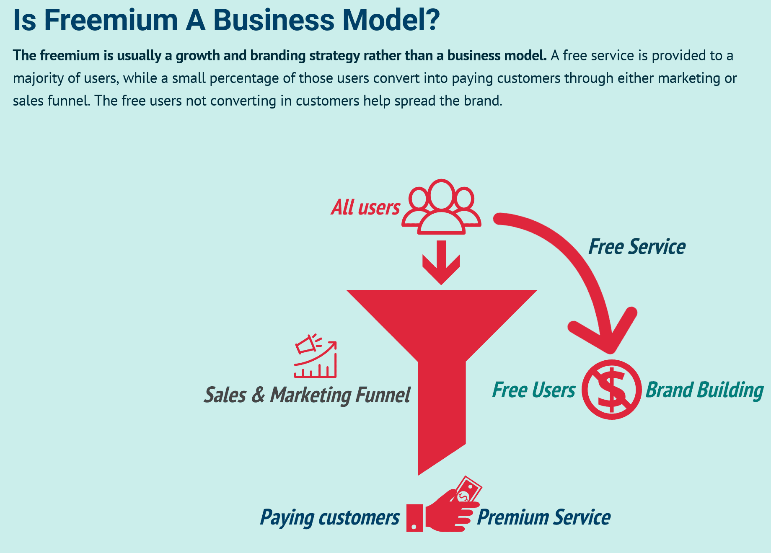
Freemium and CLV
Many software firms offer freemium versions to new customers
Free to induce trial
Then charge for upgrade as user’s needs grow
Let’s formalize this model …

Slide 46



Freemium and CLV
freemium model:
F = free version, with ad revenues $\$a$
P = paid version, with price $\$p$
Assume: after upgrading to paid, never downgrade to free
CLV for a freemium customer:
Usually $a<p$
$$F=Pr(renew Free)\left(a+δF\right)$$
Recurring cash flow
from free

Slide 47
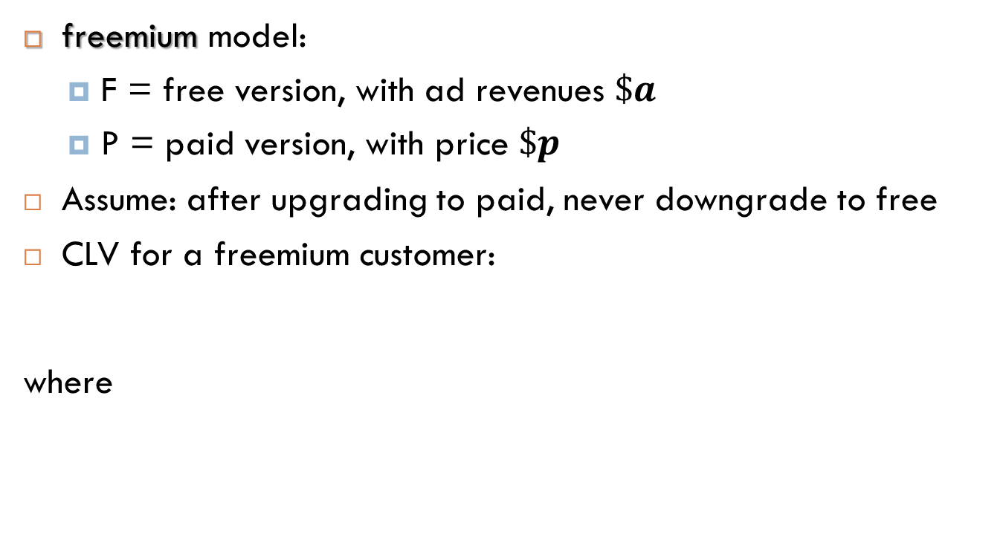

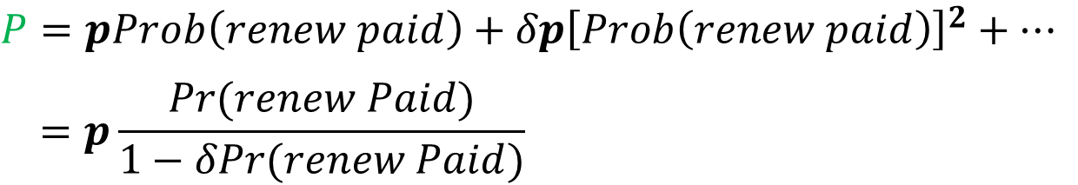
Freemium and CLV
freemium model:
F = free version, with ad revenues $\$a$
P = paid version, with price $\$p$
Assume: after upgrading to paid, never downgrade to free
CLV for a freemium customer:
where
Usually $a<p$
$$F=Pr(renew Free)\left(a+δF\right)+Pr(Paid upgrade)(p+δP)$$
Potential acquired cash
flows from paid
$$P=pProb\left(renew paid\right)+δp{\left[Prob\left(renew paid\right)\right]}^{2}+…$$
$$=p\frac{Pr(renew Paid)}{1−δPr(renew Paid)}$$
Careful: $Pr(renew Paid)$ probably depends on $p$ and falls as $p↑$

Slide 48
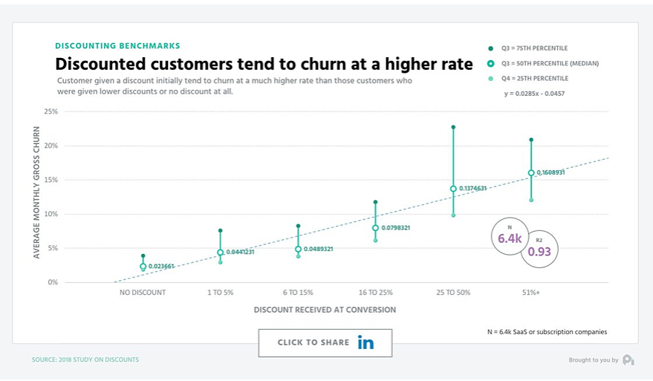
Selection effects of introductory pricing Discounting to juice acquisition rates
Customers acquired via discount may be most likely to churn.
Makes sense, discounts mechanically select low-value customers at the margin!
Optimized CLV pricing must balance acquisition & retention.

Slide 49
Extra
CLV at Ziprecruiter using simulated data.
R code
Results
Figures

Slide 50
Data and code overview
The actual Ziprecruiter data are confidential and cannot be circulated
So in this Appendix I will provide R code you can use:
to simulate hypothetical purchase data
to estimate demand
to compute optimal monthly prices
to compute optimal prices against the CLV of the customer
Although these are simulated data, I set them up to mimic the actual choice behavior from out experiment

Slide 51
The Logistic model
To predict membership demand at different price levels, I estimated a “Logit” model
The model predicts the probability of buying at a given price
$$Prob\left(Pay for month of service|Price\right)=\frac{exp\left(β_{0} +β_{1}Price\right)}{1+exp\left(β_{0} +β_{1}Price\right)}$$

Slide 52
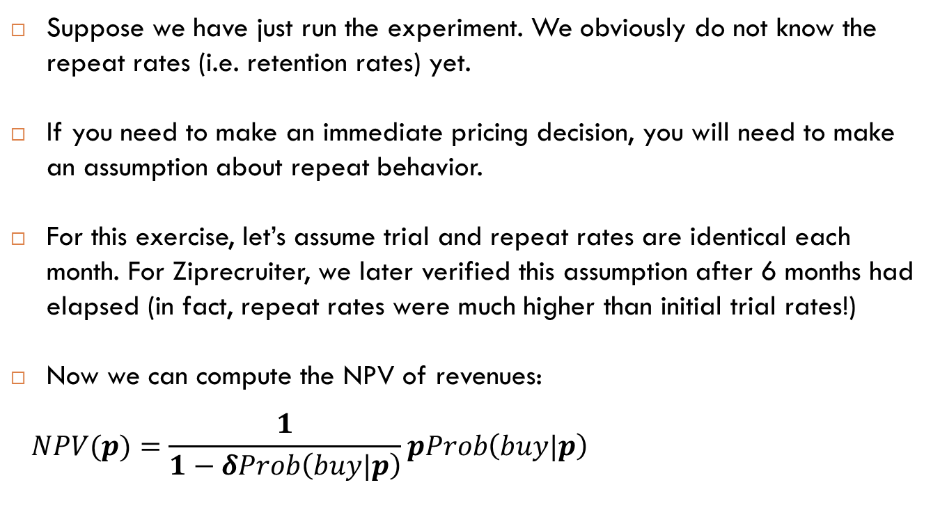
The Logistic model and NPV
Suppose we have just run the experiment. We obviously do not know the repeat rates (i.e. retention rates) yet.
If you need to make an immediate pricing decision, you will need to make an assumption about repeat behavior.
For this exercise, let’s assume trial and repeat rates are identical each month. For Ziprecruiter, we later verified this assumption after 6 months had elapsed (in fact, repeat rates were much higher than initial trial rates!)
Now we can compute the NPV of revenues:
$$NPV(p)=\frac{1}{1−δProb\left(buy|p\right)}pProb\left(buy|p\right)$$

Slide 53
A simulation in R to illustrate Code to create simulated choice data
The next few slides replicate the logit simulation from the end of the elasticity slides in week 2
N = 8000 # number respondents
betatrue = matrix(c(-0.64,-0.004)) # inter. & price coeff
testprices=matrix(c(19,39,59,79,99,159,199,249,299,399))
Price = sample(testprices,size=N,replace=T) # randomize prices
epsilon = -log(-log(runif(N))) +log(-log(runif(N))) # draw logistic errors
U = betatrue[1]+betatrue[2]*Price+epsilon # buying utility
Y = (U>0)*1 # choice data

Slide 54
A simulation in R to illustrate Demand Estimation
### Estimate Logistic demand using R's built-in function "glm"
out = glm(Y~Price,family="binomial")
betahat = out$coefficients

Slide 55
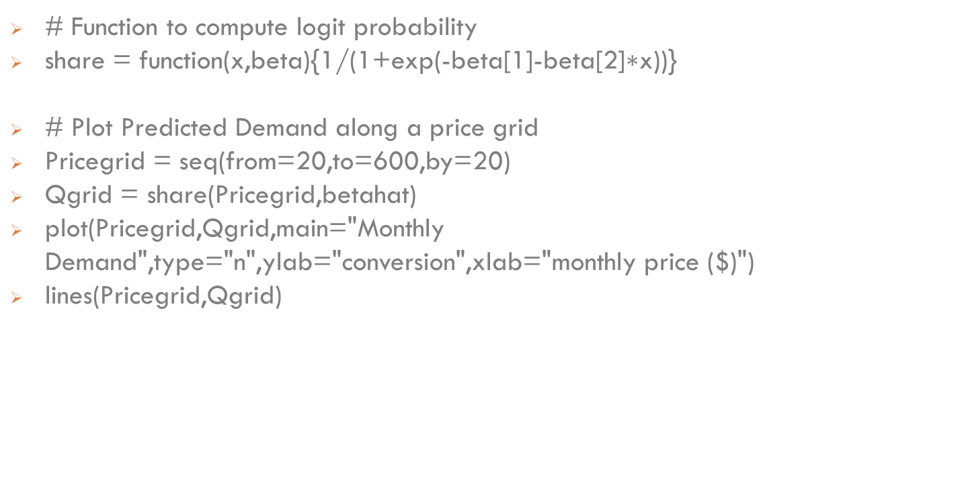
A simulation in R to illustrate Plot demand estimates
# Function to compute logit probability
share = function(x,beta){1/(1+exp(-beta[1]-beta[2]$\text{∗}\text{x}$))}
# Plot Predicted Demand along a price grid
Pricegrid = seq(from=20,to=600,by=20)
Qgrid = share(Pricegrid,betahat)
plot(Pricegrid,Qgrid,main="Monthly Demand",type="n",ylab="conversion",xlab="monthly price ($)")
lines(Pricegrid,Qgrid)

Slide 56
A simulation in R to illustrate Plot demand estimates

Slide 57
A simulation in R to illustrate Compute Monthly Revenue-maximizing price
# Function to compute expected montly revenue
Erevenue = function(x,beta){share(x,beta)*x}
# Optimal static monthly price
Pstar = round(optimize(Erevenue,c(0,1000),beta=betahat,maximum=T)$maximum)

Slide 58
A simulation in R to illustrate Plot Predicted Monthly Revenue & optimal price
#Plot Predicted Monthly Revenue
Revgrid = Qgrid*Pricegrid
plot(Pricegrid,Revgrid,main="Monthly Revenue",type="n")
lines(Pricegrid,Revgrid,col="navy")
lines(c(Pstar,Pstar),c(0,revenue(Pstar,betahat)),lty=2,col="navy")
text(Pstar,revenue(Pstar,betahat),paste("optimal price: $",Pstar,sep=""),pos=1,cex=.5,col="navy")

Slide 59
A simulation in R to illustrate Plot Predicted Monthly Revenue & optimal price

Slide 60
A simulation in R to illustrate Compute NPV of Revenue maximizing price
#Function to compute NPV of Revenue
NPVrevenue = function(p,beta,delta){1/(1-delta*share(p,betahat))*(share(p,betahat)*p)}
# Compute NPV-maximizing price
delta = .995
PstarLR = round(optimize(NPVrevenue,c(0,1000),beta=betahat,delta=delta,maximum=T)$maximum)

Slide 61
A simulation in R to illustrate Plot monthly revenue and NPV revenue functions
# Compute NPV of Revenues along the price grid
NPVRevgrid = NULL
for(tt in 1:length(Pricegrid)) {NPVRevgrid = rbind(NPVRevgrid,NPVrevenue(Pricegrid[tt],betahat,delta))}
#Plot Predicted Monthly Revenue & NPV of Revenue
plot(Pricegrid,NPVRevgrid,main="Expected Monthly Revenue",type="n",ylab="expected revenue ($)",xlab="monthly price ($)")
lines(Pricegrid,Revgrid,col="navy")
lines(Pricegrid,NPVRevgrid,col="green")
lines(c(Pstar,Pstar),c(0,revenue(Pstar,betahat)),lty=2,col="navy")
text(Pstar,revenue(Pstar,betahat),paste("optimal price: $",Pstar,sep=""),pos=1,cex=.5,col="navy")
lines(c(PstarLR,PstarLR),c(0,NPVrevenue(PstarLR,betahat,delta)),col="green",lty=2)
text(PstarLR,NPVrevenue(PstarLR,betahat,delta),paste("NPV optimal price: $",Pstar,sep=""),pos=1,cex=.5,col="green")
legend("topleft",legend=c("static (delta=0)","NPV (delta=.995)"),fill=c("black","green"),cex=.7)

Slide 62
A simulation in R to illustrate Plot monthly revenue and NPV revenue functions

Slide 63
Extra
CLV at Ziprecruiter using actual retention rates

Slide 64
Pricing and CLV at Ziprecruiter
In practice, trial and repeat rates are probably different:
$Prob\left(trial|p\right)≠Prob \left(retention | p\right)$
4 months after experiment, measure actual “retention’ rate as function of price
At Ziprecruiter, retention rate higher than initial acquisition rate
Estimate repeat purchase probabilities for each of the first four months using the same customers from the experiment
assume repeat probability remains fixed after 4 months

Slide 65
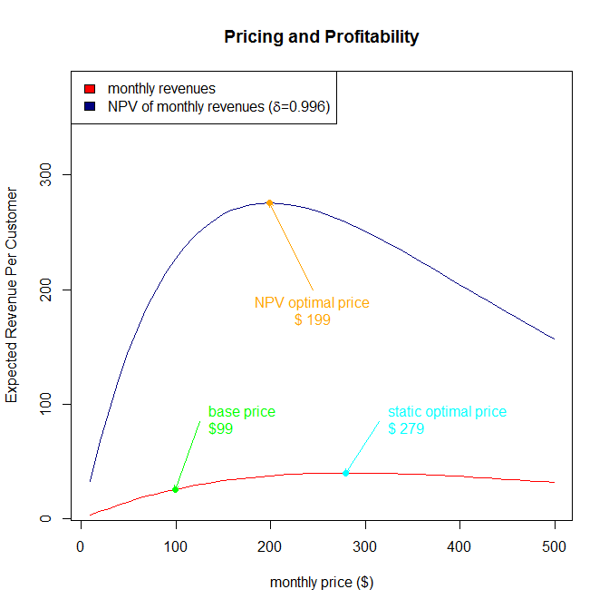
Pricing and CLV at Ziprecruiter use data to measure retention
(r=0.05)
$290
Optimal price for lifetime value even lower: $199

